Slide 1


Venture Capital and Private Equity
under a Modern Optimization Lens
15.095 Presentation
Edoardo Italia | Simon Weill
December 2020

Slide 2
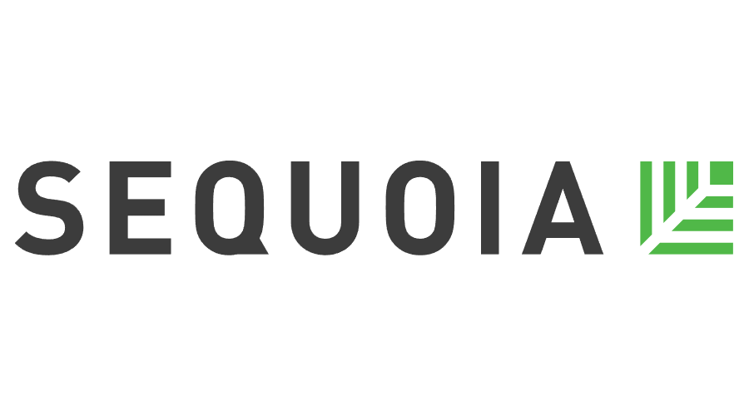







Private investment markets reach historical records
Quality of Life
Untreated Patients
$ 4 Trillion in AUM¹
1) Assets Under Management in 2019

Slide 3



But Machine Learning and Optimization are rarely used
“You can’t communicate a black-box-based decision to an investment committee”
- Analyst, Investment Banking
Human judgement used to finalize investment
Generally secretive
process → lack of data
Performance estimation can be challenging

Slide 4
We propose a new approach…
“There’s a lack of talent in the sector - these technologies are not fully leveraged”
- Investor, Private Equity
Data and Modeling
Decisions
Value
Lasso, CART, ORT, Random Forest, Boosted Trees,
Predicted returns
Mixed Integer Optimization
Optimal strategy
Capital allocation

Slide 5
…leveraging a smart clustering method
Cluster C₁
μ[μ(ARR_{i,C1})]
μ [σ(ARR_{i,C1})]
Year 1 Prediction | Year 2 Prediction | Year 3 Prediction
Y_{1,1} | Y_{1,2} | Y_{1,1}
Y_{2,1} | Y_{2,2} | Y_{2,3}
Y_{3,1} | Y_{3,2} | Y_{3,3}
Avg. Annual Return
μ(ARR₁)
μ(ARR₂)
μ(ARR₃)
Std. Annual Return
σ(ARR₁)
σ(ARR₂)
σ(ARR₃)
Cluster C_{k}
Y_{n,1} | Y_{n,2} | Y_{n,3}
μ(ARR_{n})
σ(ARR_{n})
μ[μ(ARR_{i,Ck})]
μ [σ(ARR_{i,Ck})]

Slide 6
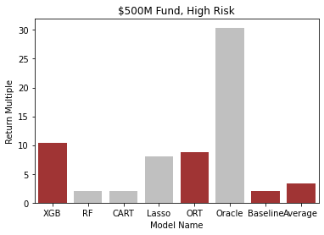
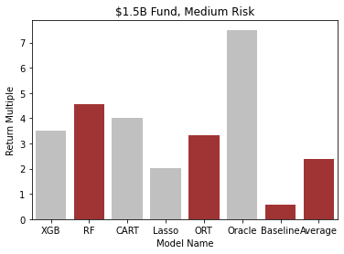
Machine Learning and Optimization CAN be used!
Our novel approach leads to substantially
higher returns independent of fund size or risk appetite

Slide 7



Where do we go from now?
Leverage additional datasets,
for more complete descriptors
Explore alternative risk metrics + optimization formulations
Reach out to industry for potential implementation

Slide 8
THANK YOU
Prof. Bertsimas and TA Team!
THANK YOU

Slide 9

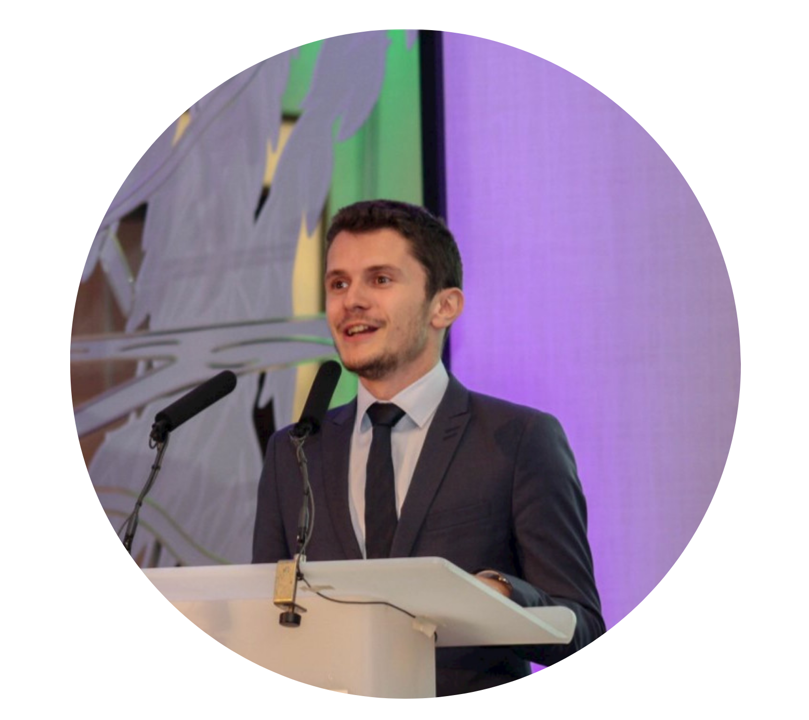
Questions?
Edoardo Italia
MBAn ‘21
Simon Weill
MBAn ‘21
eitalia@mit.edu
sweill@mit.edu
TA Supervisor: Vassilis Digalakis

Slide 10
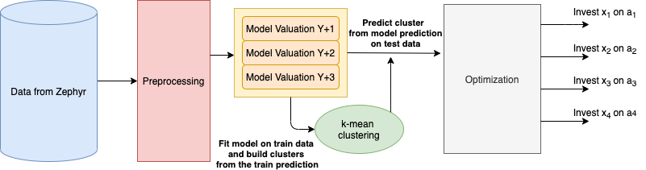
Appendix – Model Pipeline

Slide 11
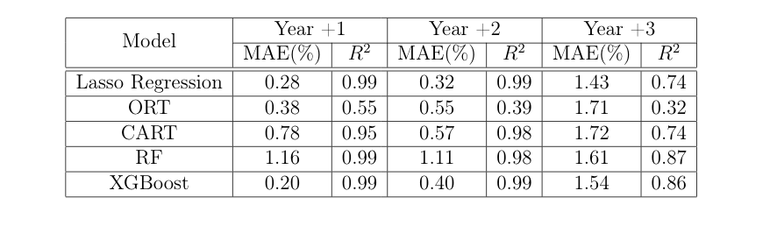
Appendix - Results

Slide 12
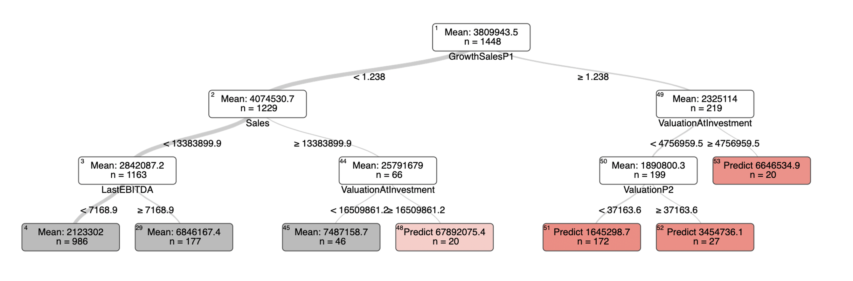
Appendix – Interpretable Trees

Slide 13
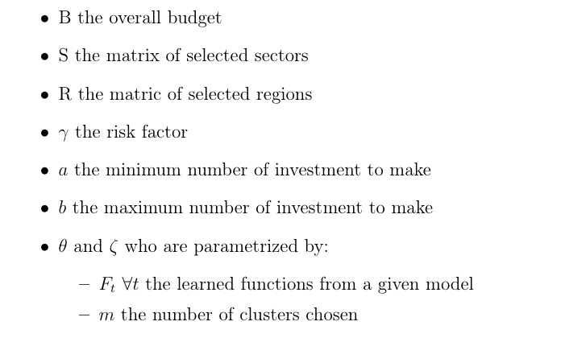
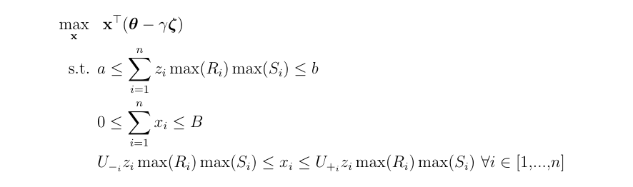
Appendix – MIO Formulation

